Slide 1
Introduction to Probabilistic
Robot Mapping

Slide 2
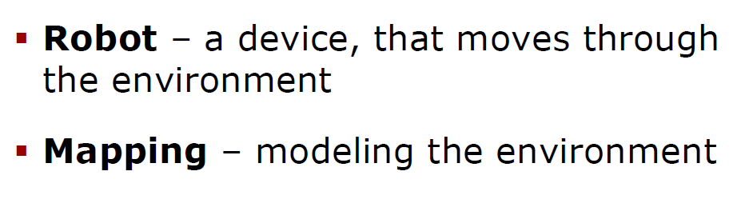
What is Robot Mapping?
General Definitions for robot mapping

Slide 3
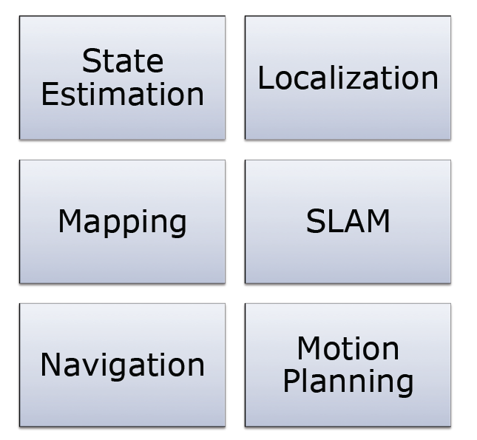
Terms and concepts related to Robot Mapping

Slide 4
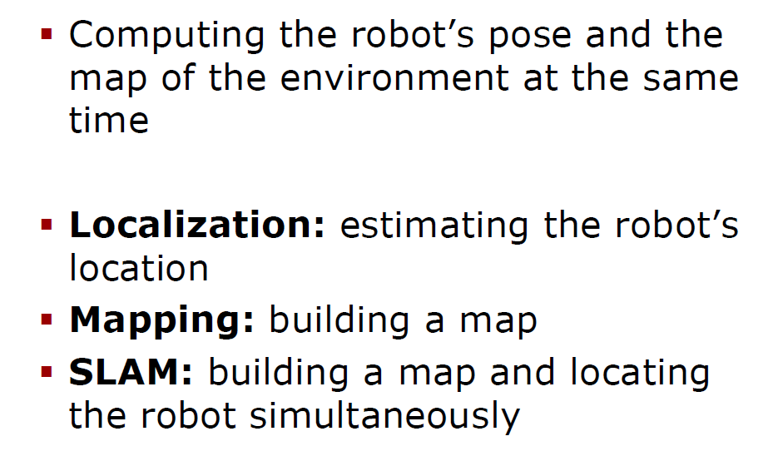
What is SLAM?

Slide 5
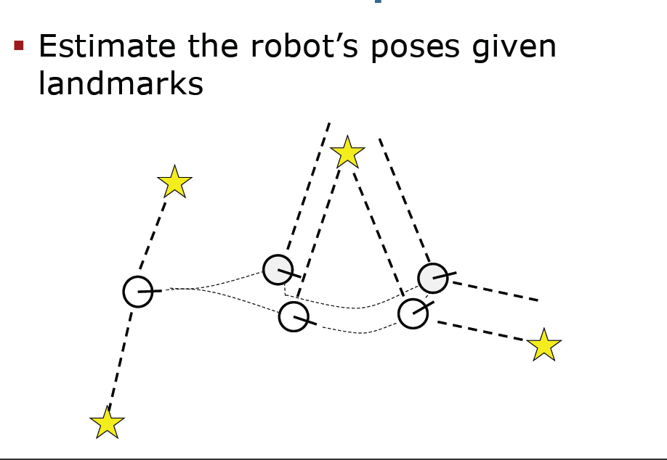
Example of Localization for a mobile robot
Yellow means fixed firm information
Predicted state
Robot knows map
Robot knows landmarks on map
Robot sees landmarks
Robot wants to estimate its pose

Slide 6
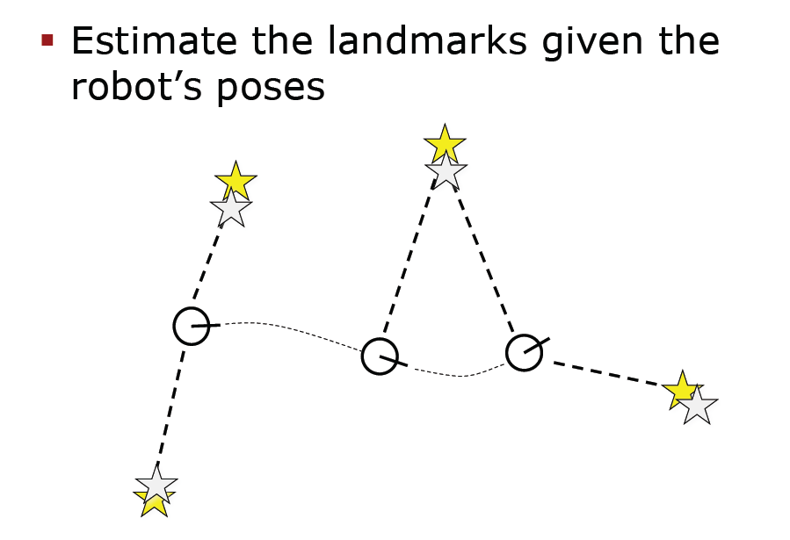
Example of Mapping
Robot creates the map
estimate
given
Robot does not know the map or its part
Robot knows its pose
Robot sees landmarks
Robot wants to estimate landmarks on the map to create or update or extend the map.

Slide 7
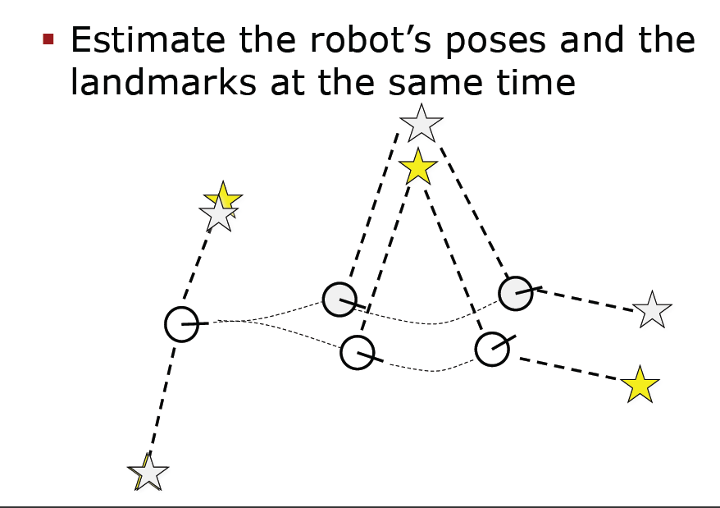
Example of SLAM
Predicted value
Real value
Robot does not know the map or its part
Robot estimates its pose
Robot sees landmarks
Robot wants to estimate landmarks on the map to create or update or extend the map.

Slide 8
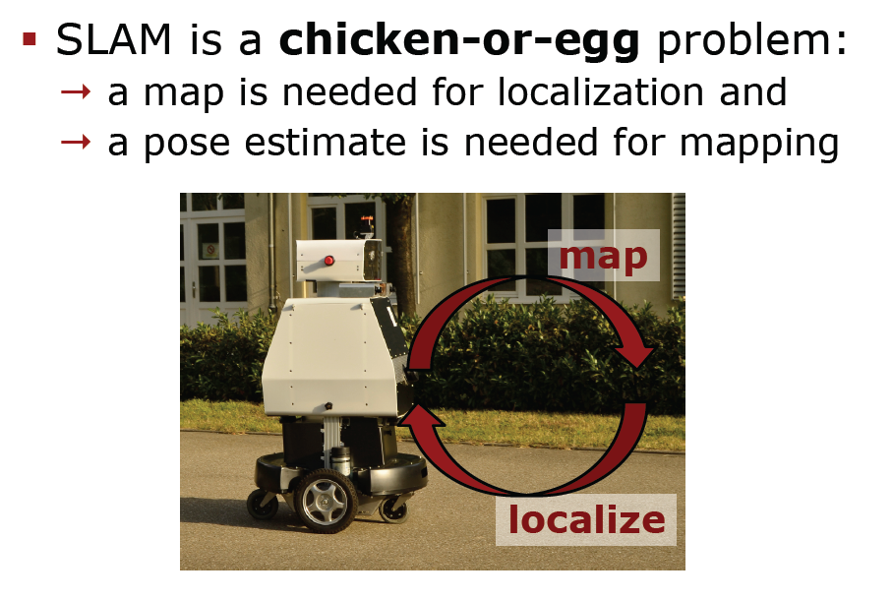
The SLAM problem is chicken-or-egg problem

Slide 9
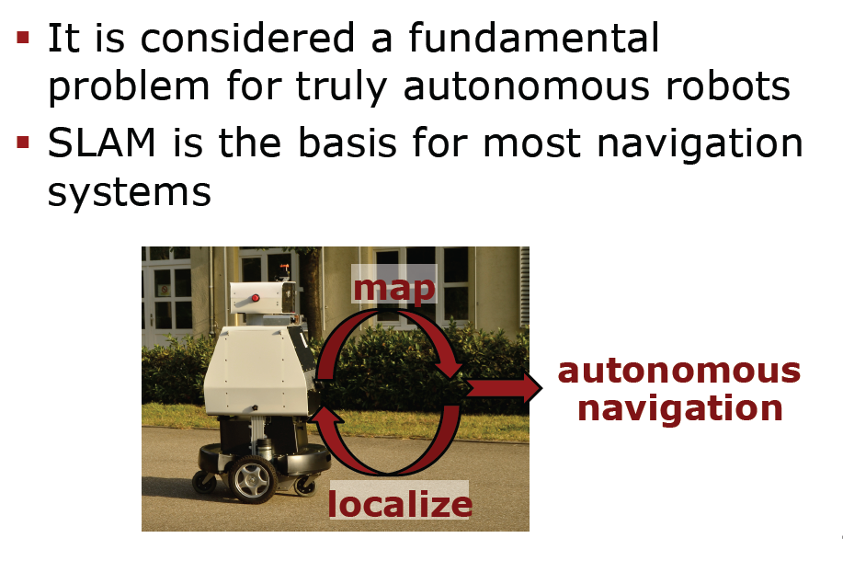
SLAM Problem is very important
SLAM is the fundamental problem in robot navigation.
You cannot avoid it.

Slide 10
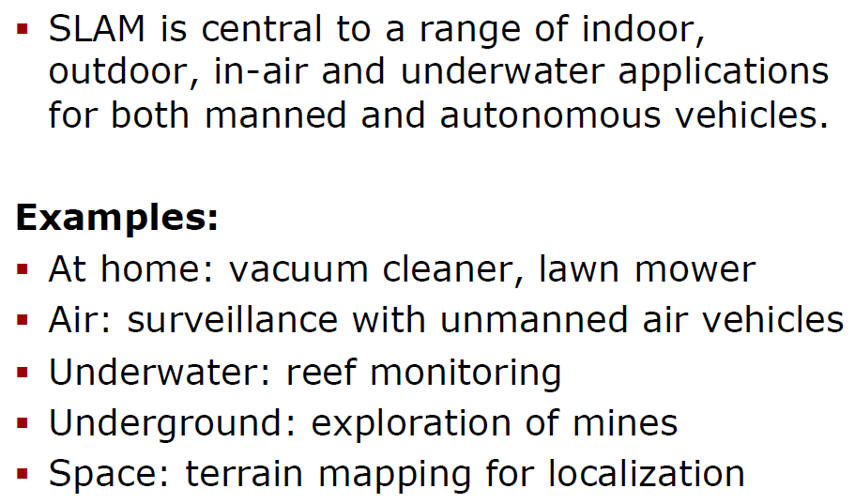
Applications of SLAM
In MCECSBOT we do not have SLAM as the map is known. SLAM can be used for furniture only and items that are not on a map of the building

Slide 11
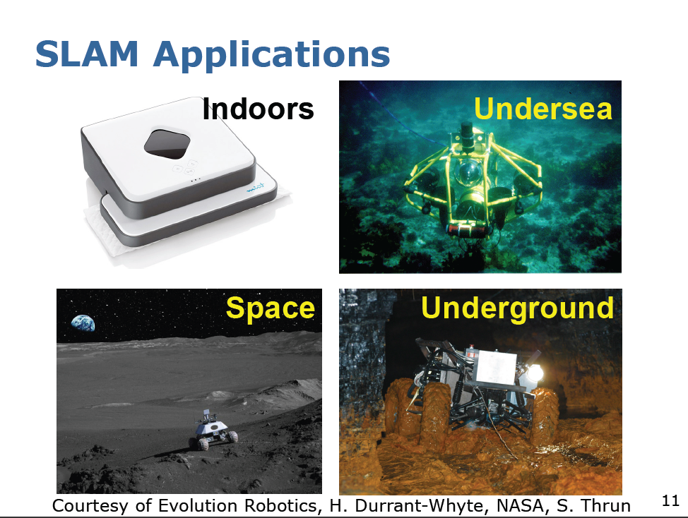

Slide 12
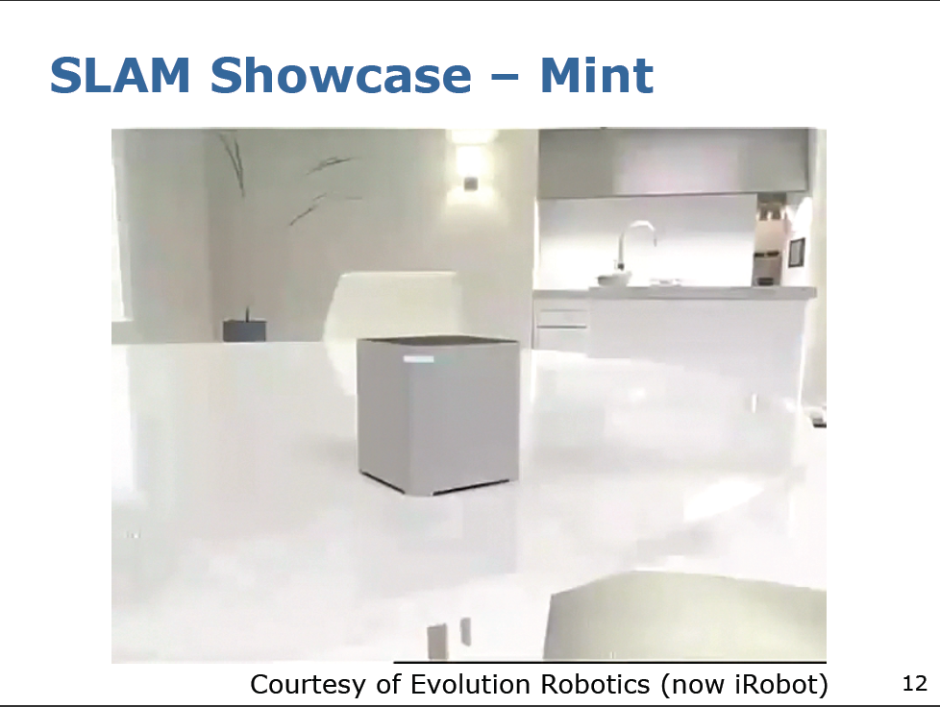

Slide 13
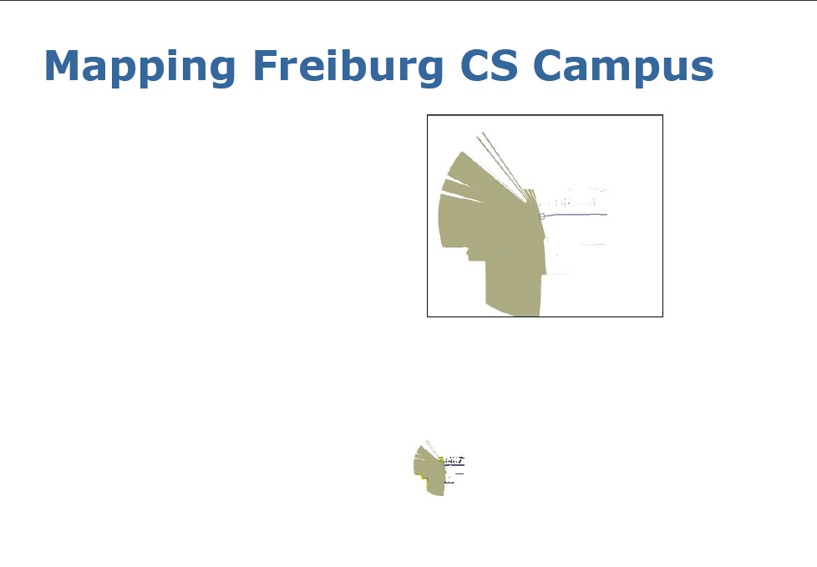

Slide 14
Formal
Definition of the SLAM Problem

Slide 15
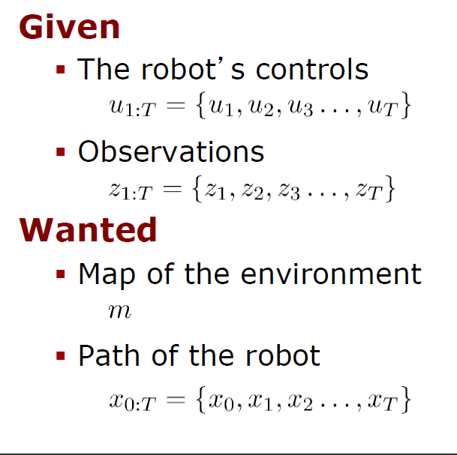
Definition of the SLAM Problem

Slide 16
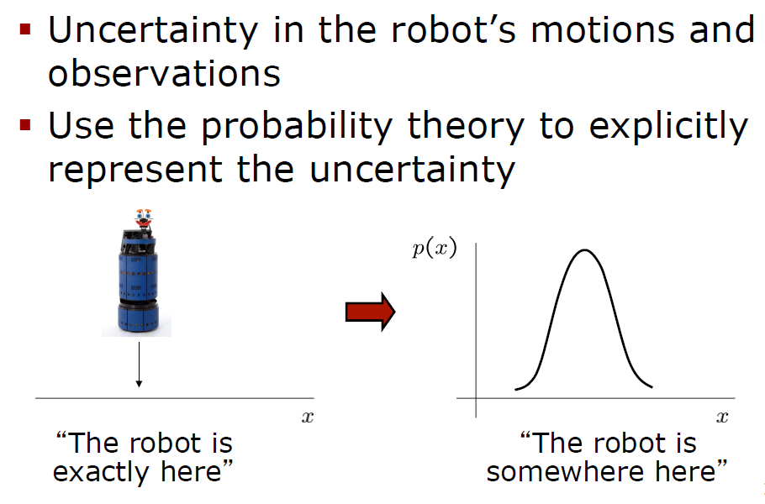
All our work is based on
Probabilistic Approaches

Slide 17
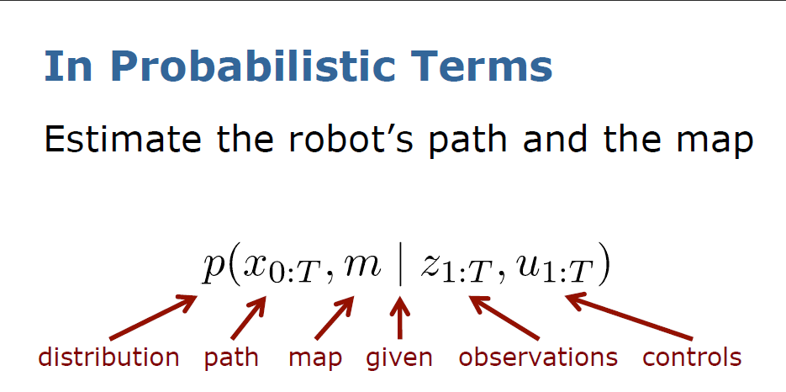
Representation of robot’s uncertainty in probabilistic terms
We use the same notation as in past lectures

Slide 18
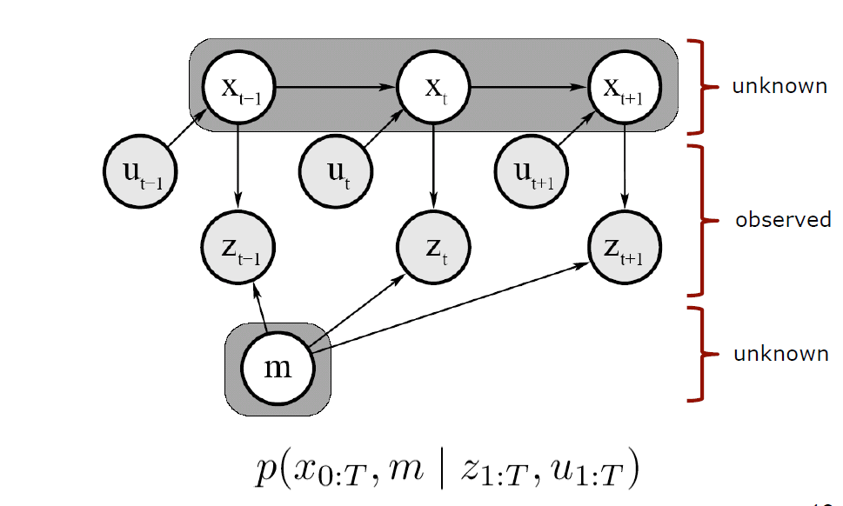
Graphical Model of Full SLAM
path
controls
observations
map

Slide 19
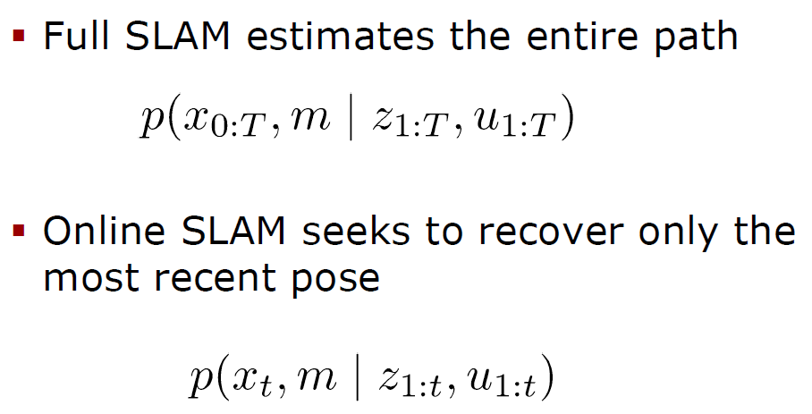
Full SLAM versus Online SLAM

Slide 20
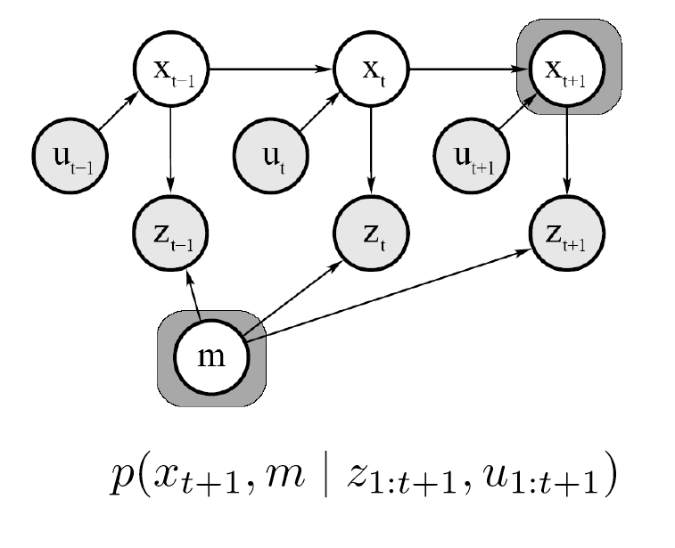
Graphical Model of Online SLAM
FULL SLAM
Let us compare full SLAM and Online SLAM

Slide 21
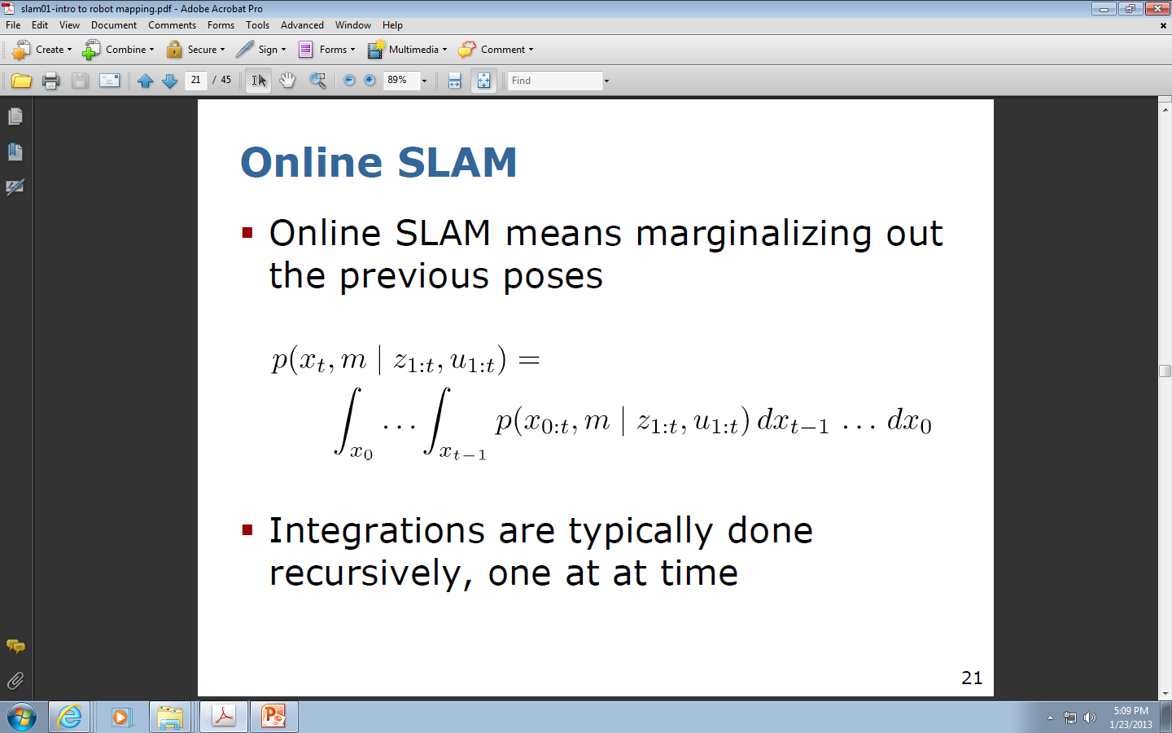
Online SLAM

Slide 22
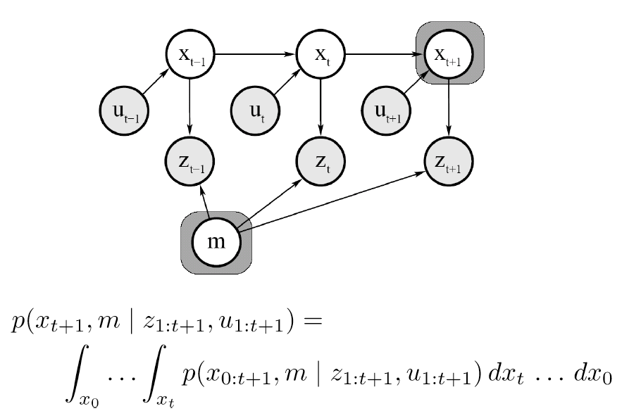
Graphical Model of Online SLAM to explain the integrations

Slide 23
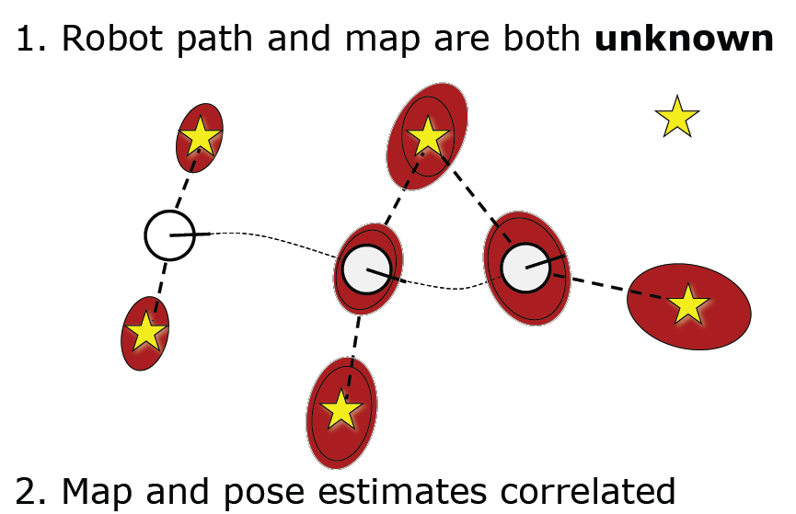
Why SLAM problem is so hard to solve?
The problem can be solved because map and pose estimates are correlated

Slide 24
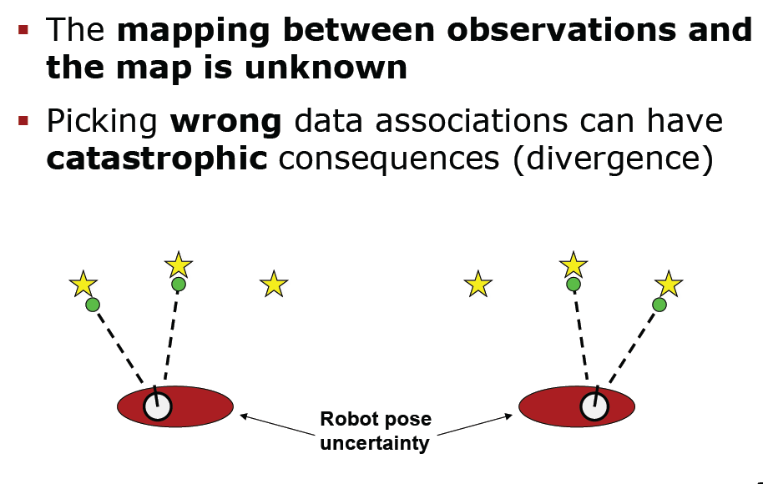
Why SLAM is a hard problem to solve?
More reasons why it is so hard.

Slide 25
Taxonomy of SLAM problems

Slide 26
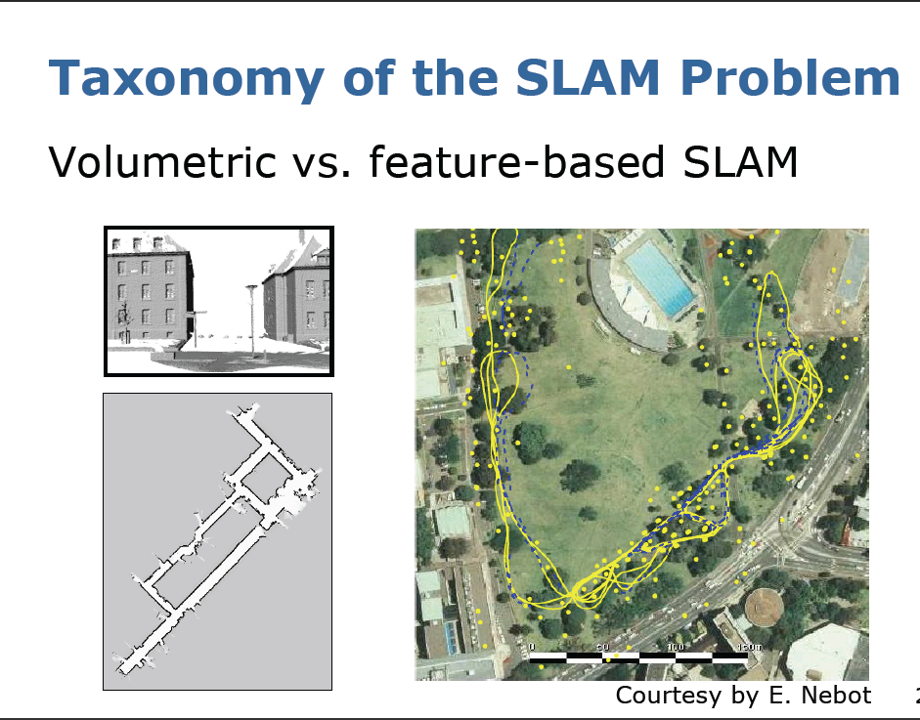

Slide 27
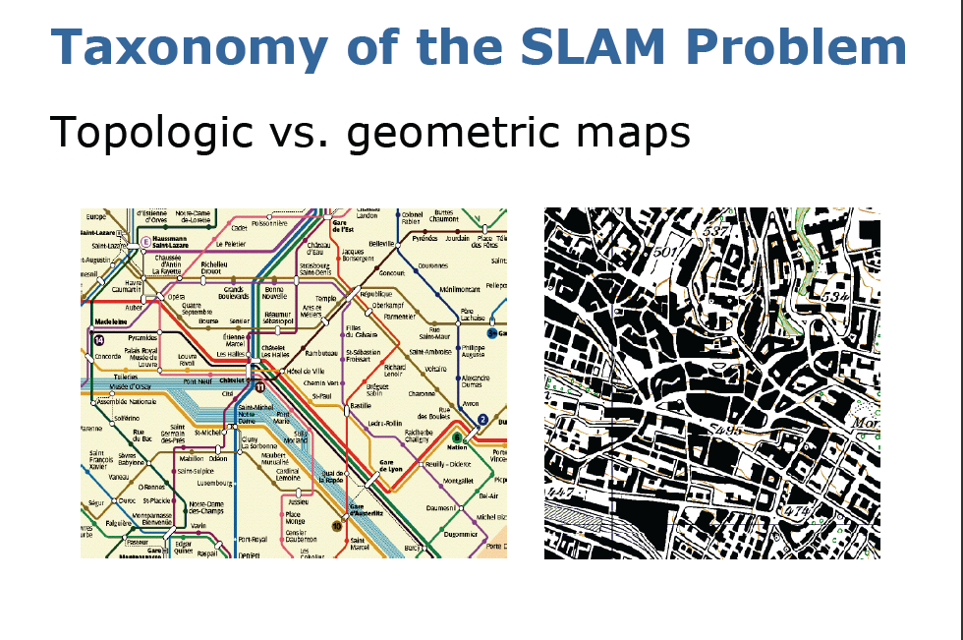

Slide 28
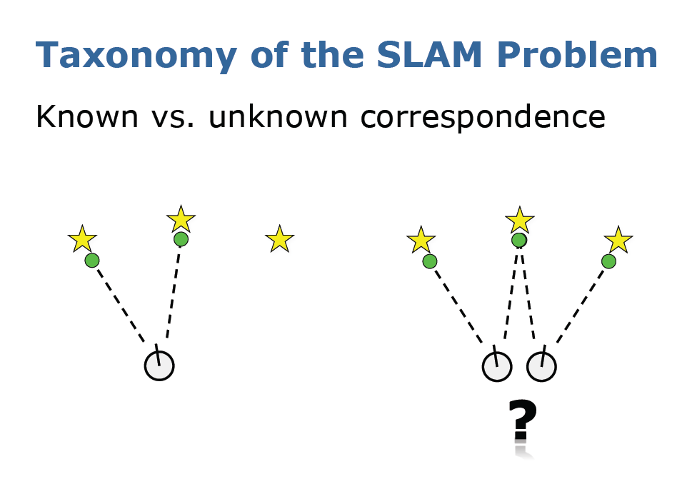

Slide 29
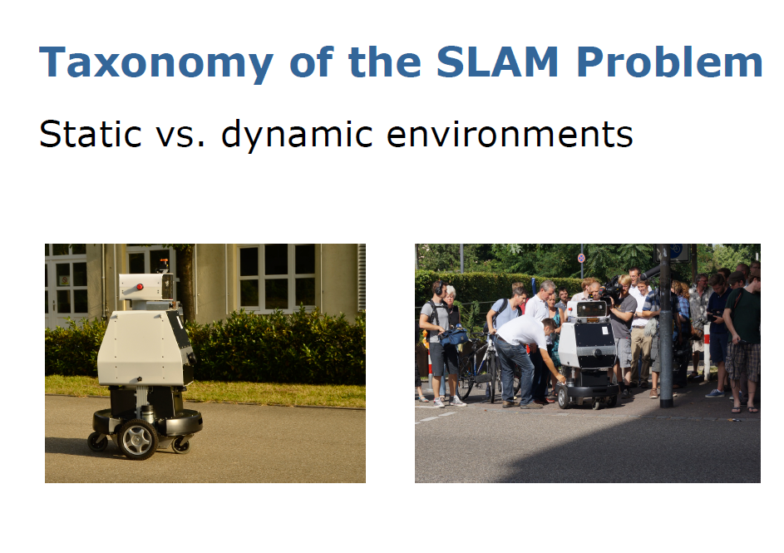

Slide 30
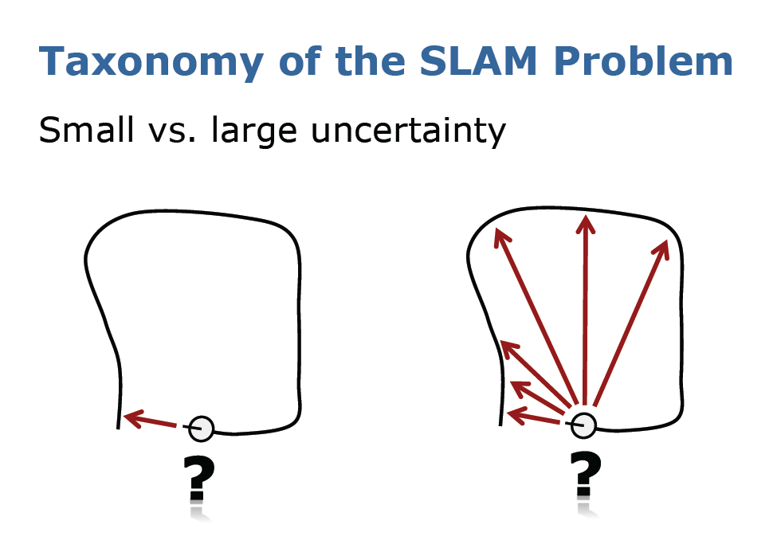

Slide 31
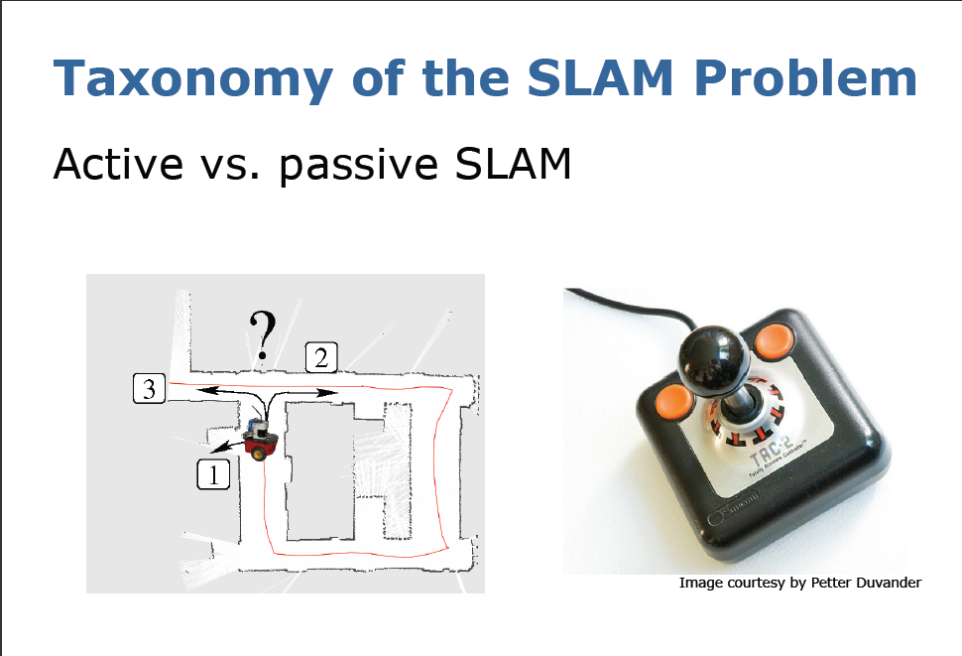
In active SLAM we have a feedback to make decision where to go next

Slide 32
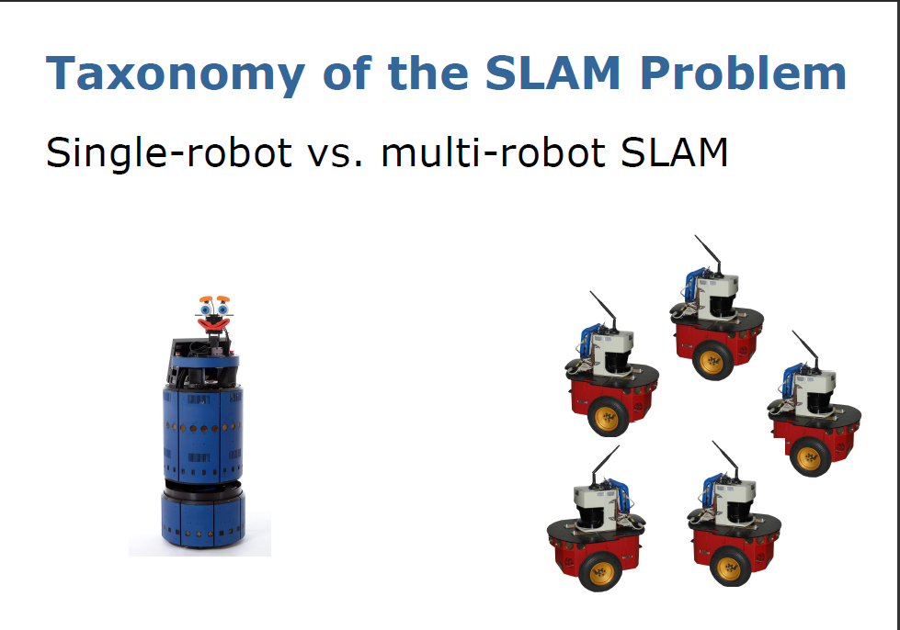

Slide 33
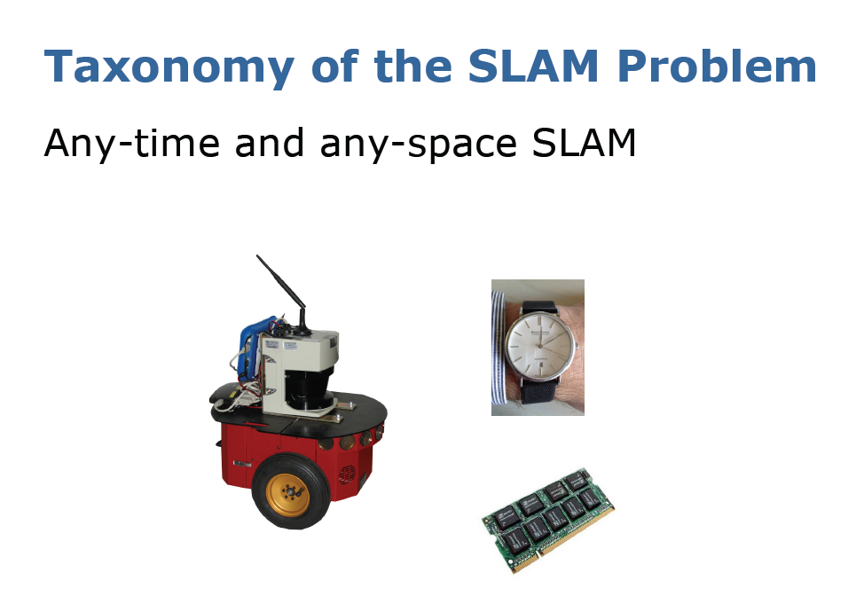
Time is restricted
Space is restricted

Slide 34
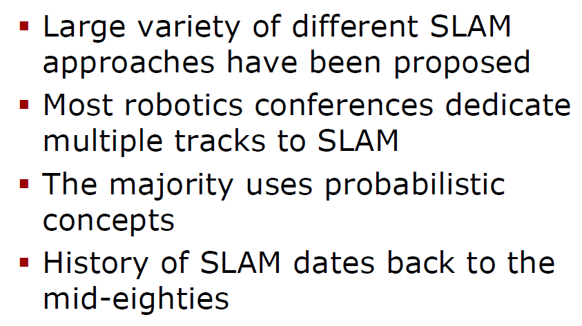
Approaches to solve the SLAM problem

Slide 35
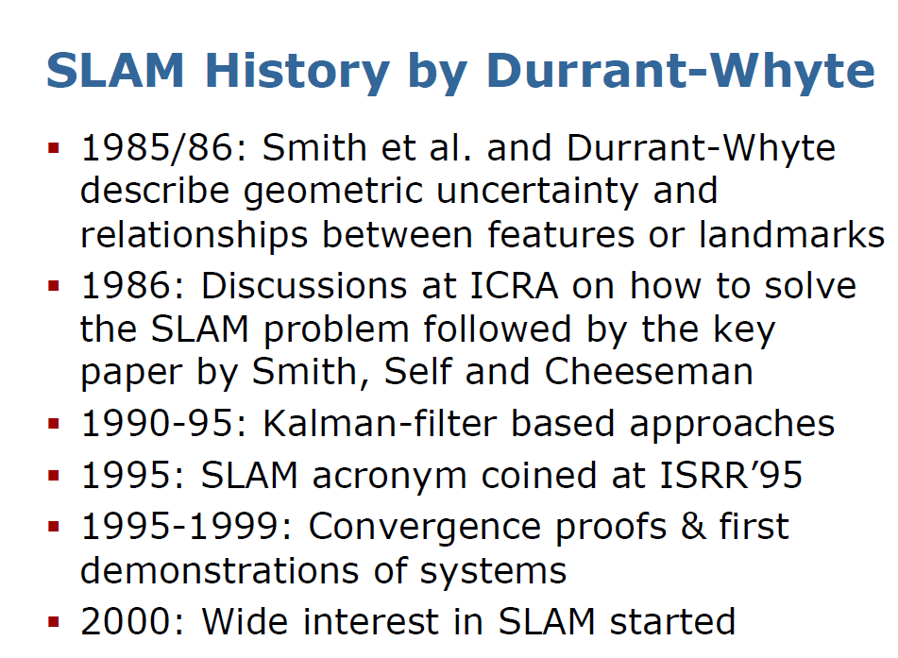

Slide 36
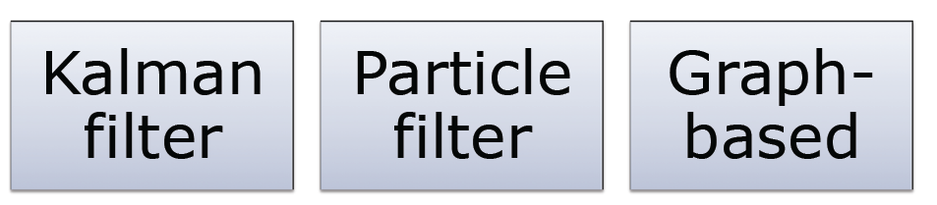
Main Paradigms for SLAM

Slide 37
Models for SLAM

Slide 38
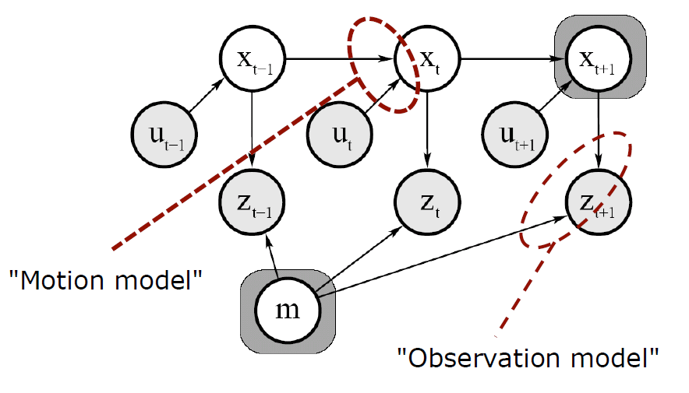
Model of Motion and Observation

Slide 39
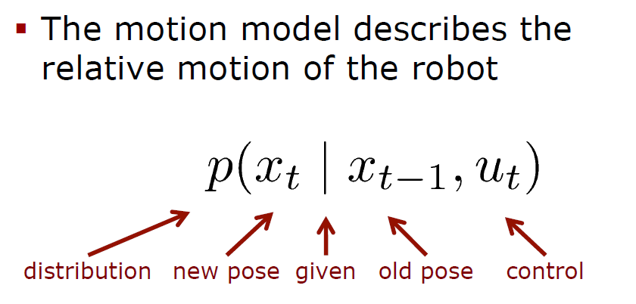
Model of Motion for SLAM

Slide 40
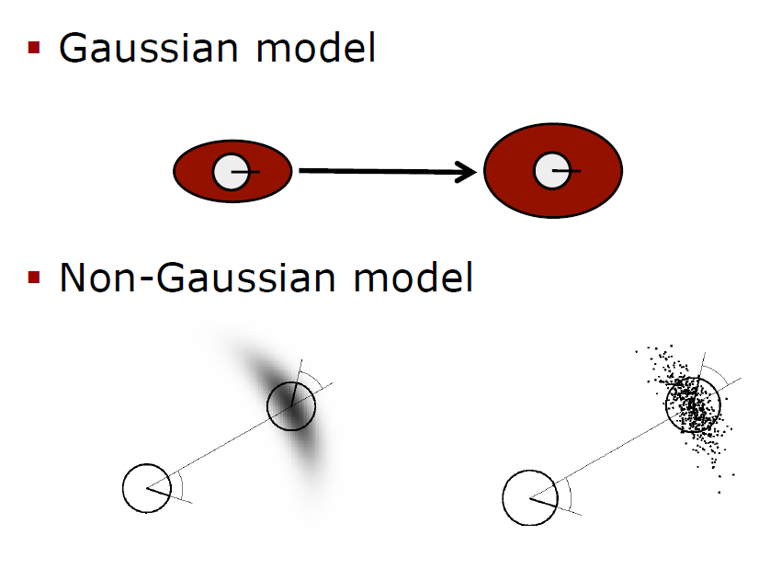
Examples of Models of Motion

Slide 41
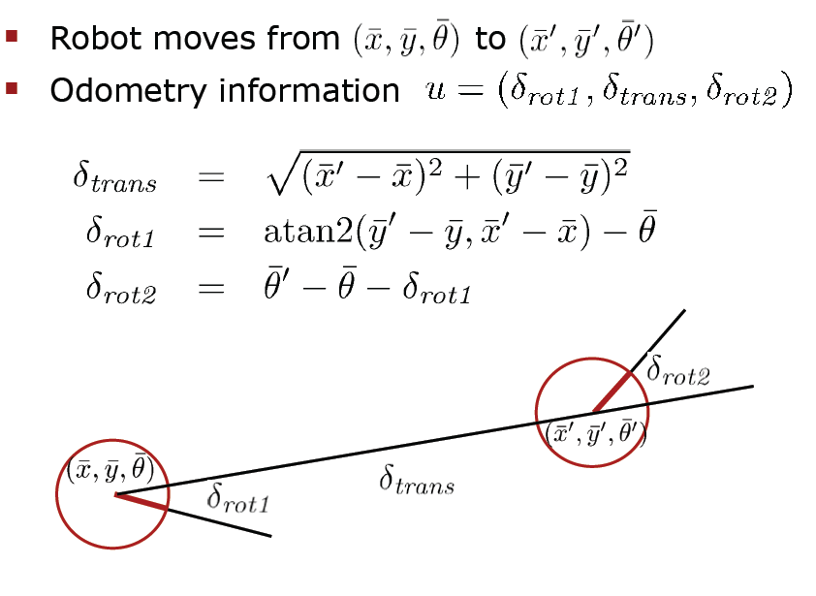
STANDARD ODOMETRY Model for motion of a robot
Calculate new data from old data and controls

Slide 42
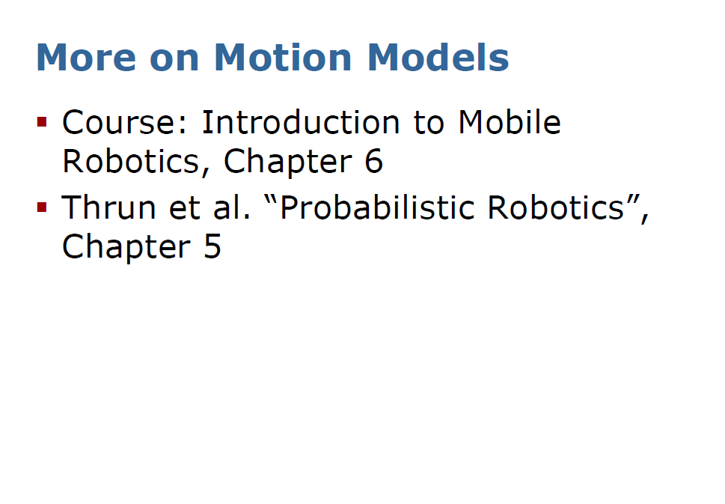

Slide 43
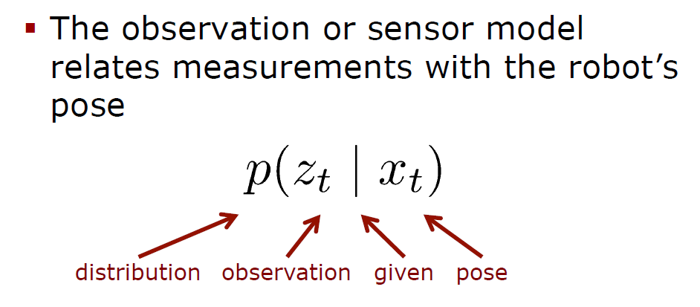
Model of Observation of Sensor

Slide 44
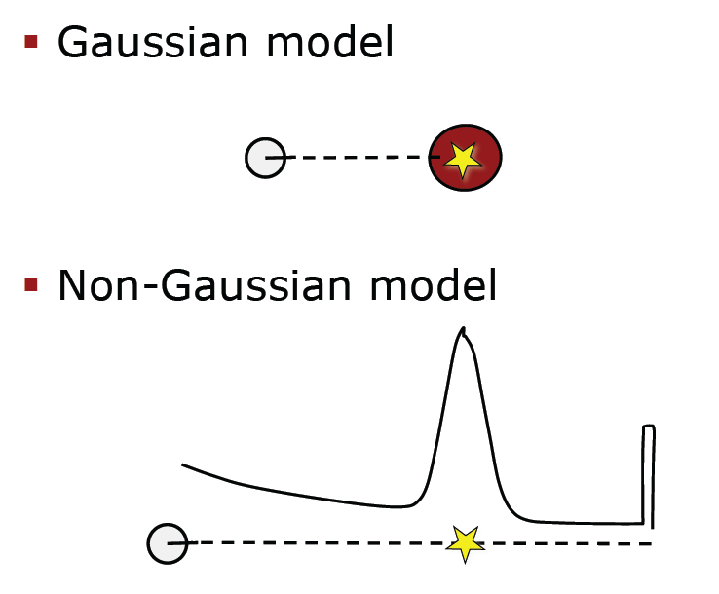
Examples of Observation Model

Slide 45
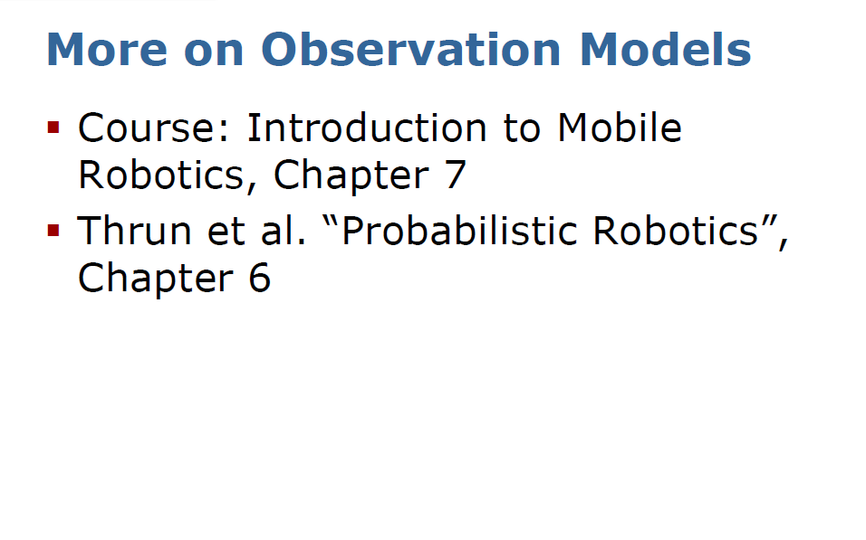

Slide 46
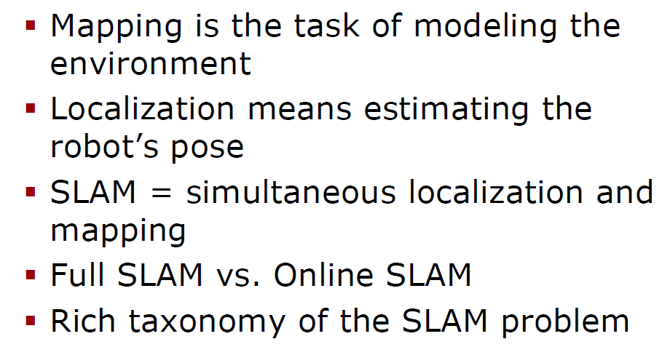
Summary on SLAM

Slide 47
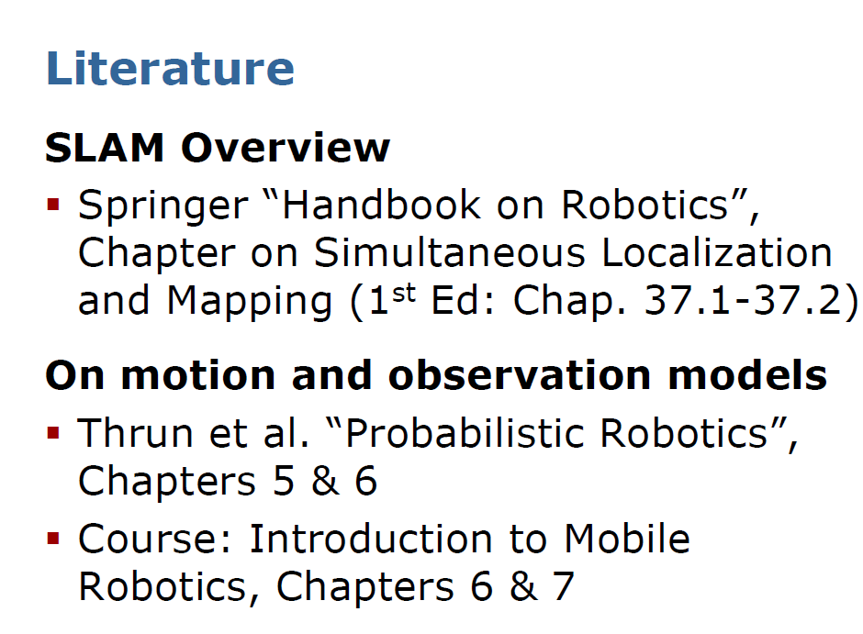

Slide 49
